Slide 1



API use for research
Session 1
www.cdcs.ed.ac.uk
Notes:
Welcome from SI and Alex , introduce Aybuke who will be helping too---- SI to talk through the introduction

Slide 2
Housekeeping and itinerary
Session 1 - Day 1 - 26/11/25
[14:00-14:20] - Talk: Introduction to APIs and use cases
[14:20-14:30]: Q & A - main goals from attendees for API use and domain
[14:30-14:40] - Talk & brief demo: Web based access for APIs (searchable interface) a short demonstration [14:40-15:00] -Talk: Understanding API documentation
[15:00-15:20] - Talk : Understanding file outputs with JSON/XML structures
10-minute break
[15:30-15:45] - Talk and demonstration: Understanding API user keys/authentication
Demonstration (Google APIs)
Final 10 minutes
Discussion: Q & A
Next session overview for practical & exercise
Record attendance & feedback
www.cdcs.ed.ac.uk
Notes:
SI to talk

Slide 3
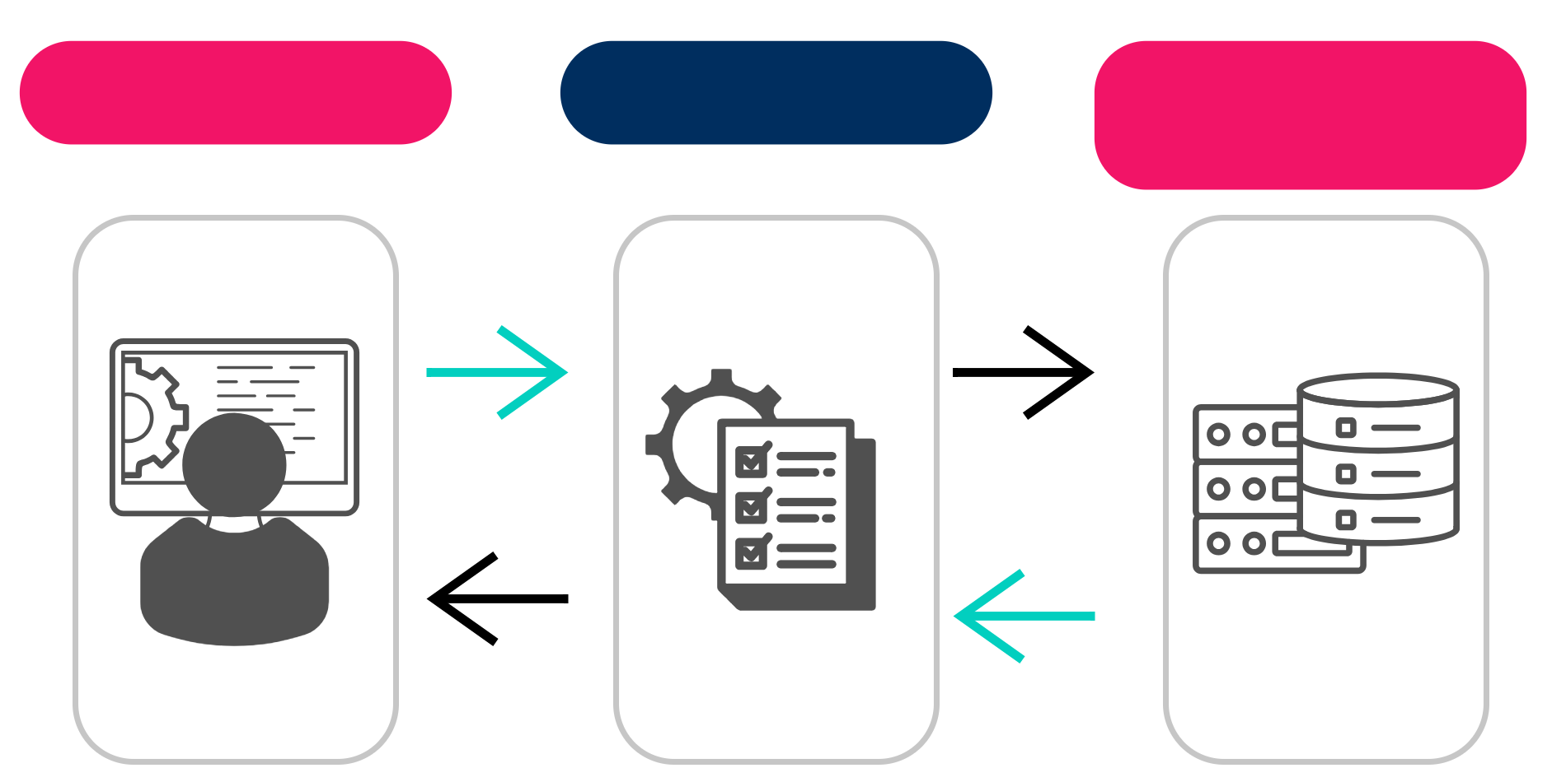
Introduction
Application Programming Interface
You
API Server/database
API
Make a request
GET
Get a response
Protocols& conditions
www.cdcs.ed.ac.uk
Notes:
SI – this is a simple overview of a web based API process, at the barebones level for an overview. We can expand this process depending on the type of API, and what is happening at the backend with servers/services/databases. Image by SI – Adobe.

Slide 4
API Types & uses
Are they open? public? Private? Internal?
Differing architectures in how these are setup
GraphQL
SPARQL
SQL
SOAP
REST
Mongo
www.cdcs.ed.ac.uk
Notes:
SI and Alex – add anything further -
Many types, each operating in slightly different ways on the backend, for use in research we need to ask whether we are working with open, public or private setups
We can broadly split by web & software library categories.

Slide 5
HTTPS and the web...
Working with a URLs
www.cdcs.ed.ac.uk
Notes:
SI and /OR Alex

Slide 6
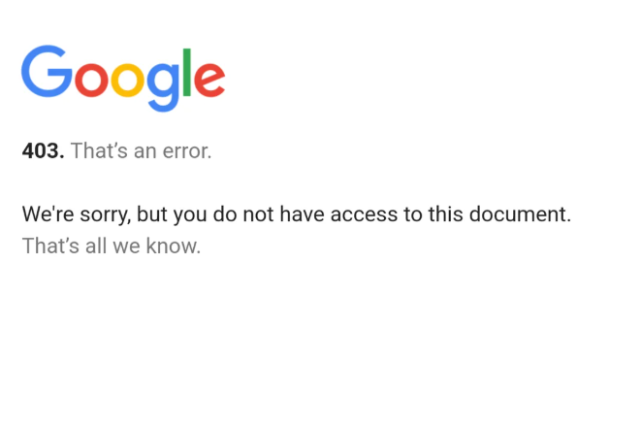
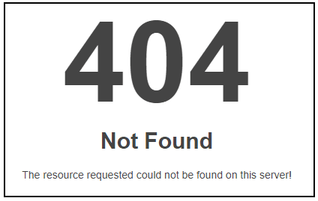
Notes:
SI – reference example to explain status codes with web APIs -

Slide 7
Discussion
What are your main goals & interest in API
www.cdcs.ed.ac.uk
Notes:
SI & ALEX prompt a discussion from the group – find out what everyone is doing and their interest in APIs

Slide 8
GUI
Different from an API: A GUI is a visual interface that allows users to interact with applications using elements like windows, buttons, and menus.
Designed to be intuitive and user-friendly, enabling real-time data manipulation and interaction
Interactive and Platform Specific
Require minimal programming skill – Often used to make initial assessments
www.cdcs.ed.ac.uk
Notes:
Example of interacting with APIs common ones that have attached GUIs for starting points and interactions

Slide 9
Understanding documentation for APIs
The user manual for an application programming interface. Each API has a controlled vocabulary, but differs between them
Instructions are clear, and updated
Specific R and Python projects also have documentation for specific APIs
www.cdcs.ed.ac.uk
Notes:
SI – use of documentation and why well documented APIs prove useful for research applications in particular.

Slide 10
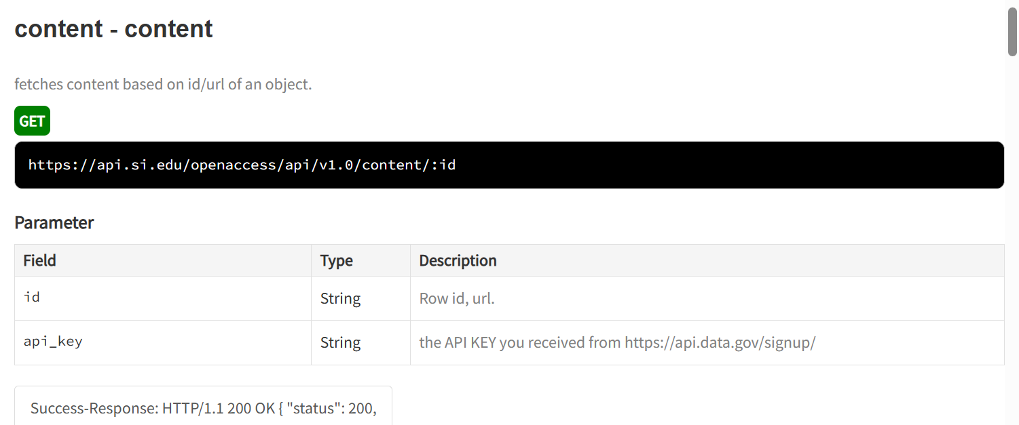
Example from Smithsonian: Documentation
www.cdcs.ed.ac.uk
Notes:
SI – use of documentation and why well documented APIs prove useful for research applications in particular.

Slide 11
Common file outputs & types
JSON
XML
RDF
CSV
www.cdcs.ed.ac.uk
Notes:
SI

Slide 12
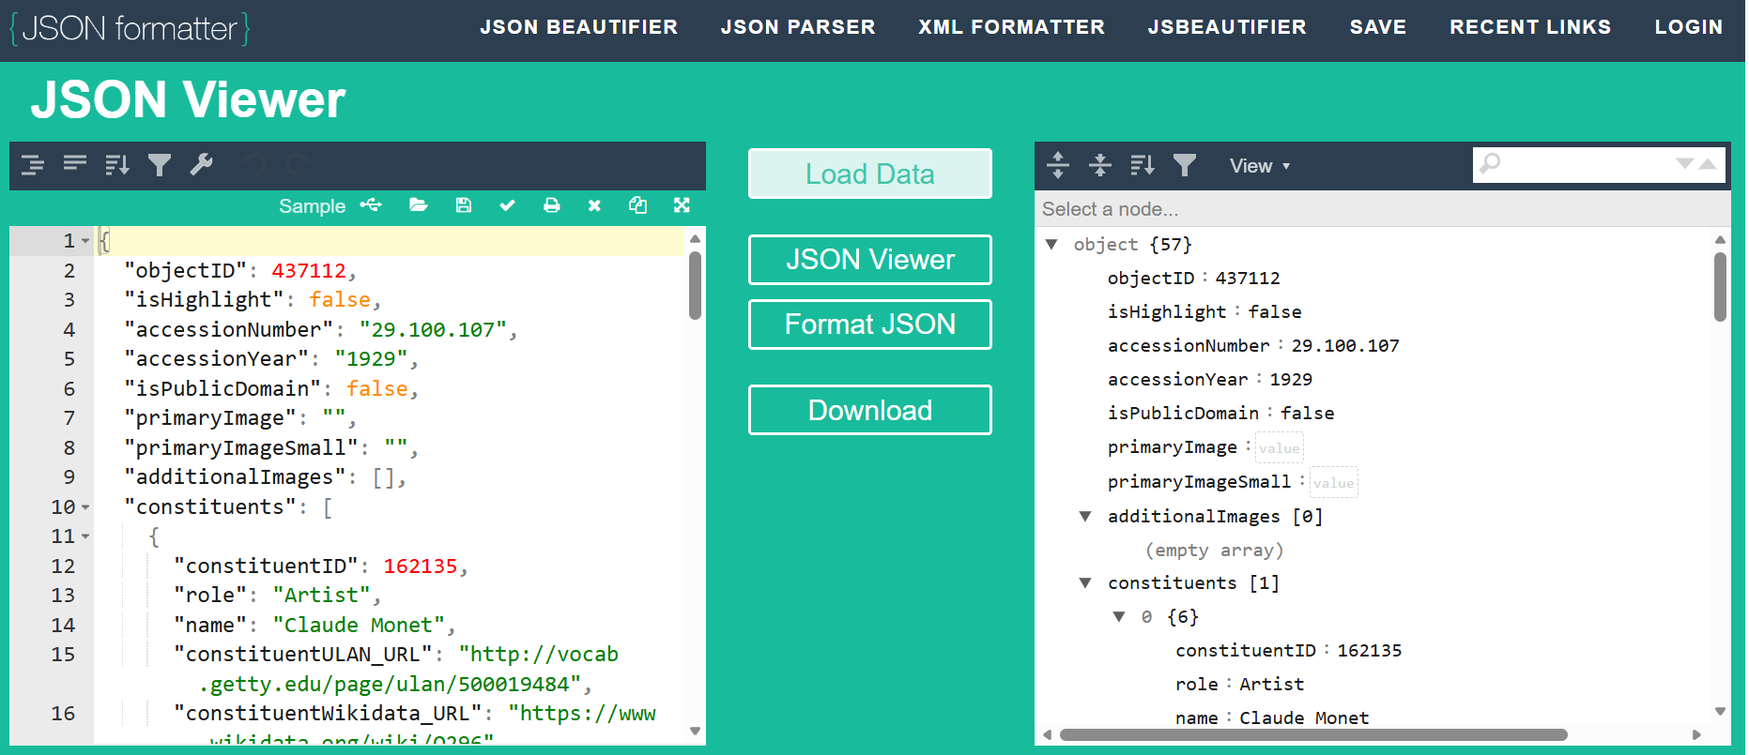
File outputs & types cont....
www.cdcs.ed.ac.uk
Notes:
SI

Slide 13
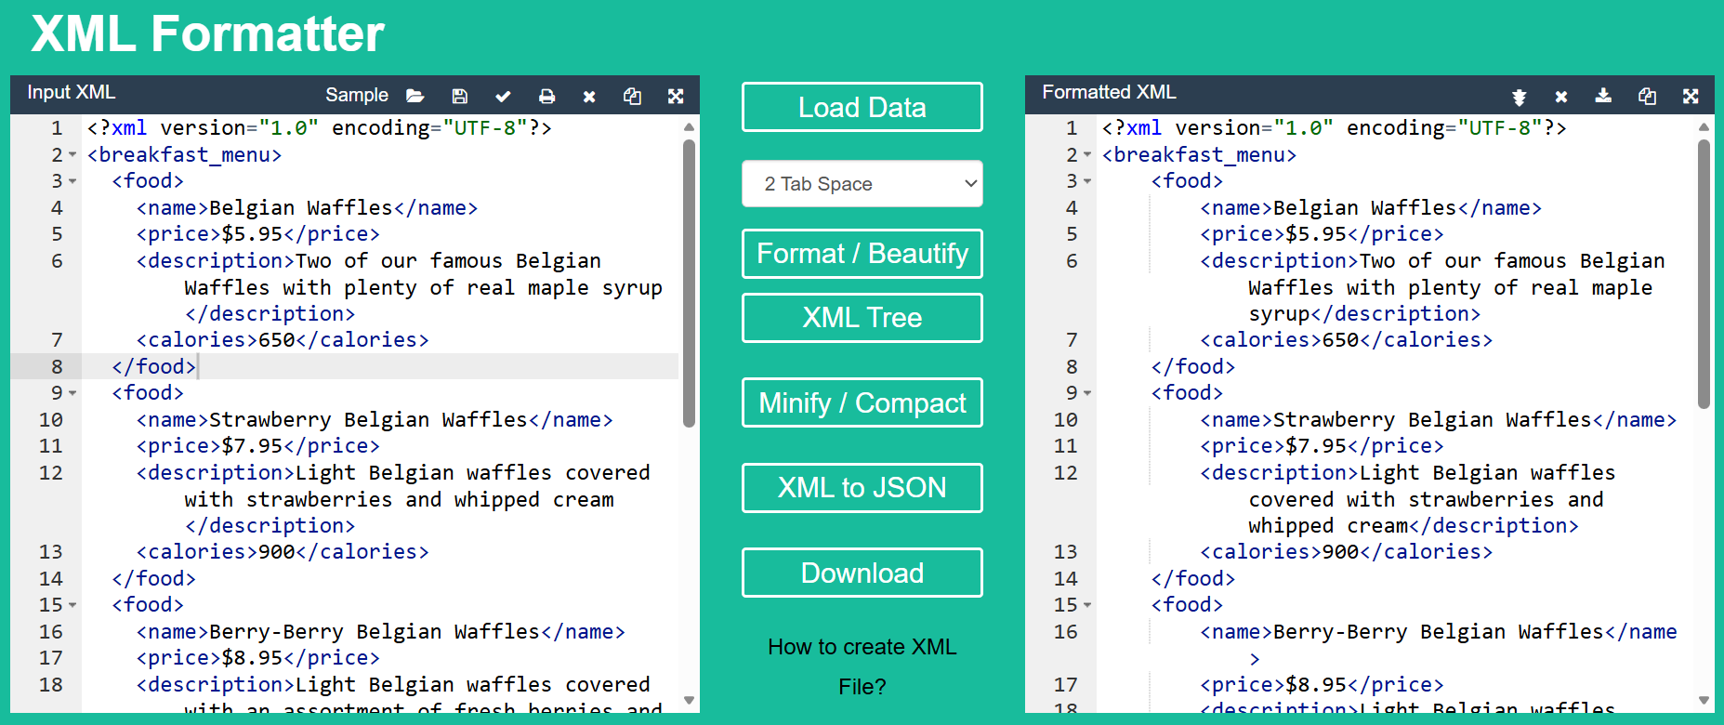
File outputs & types cont....
www.cdcs.ed.ac.uk
Notes:
SI

Slide 14
10-MINUTE BREAK
www.cdcs.ed.ac.uk
Notes:
SI

Slide 15
What are keys & authentication?
Authentication mechanisms are used to verify the identity of users and applications when accessing APIs.
An API key is a unique identifier used to authenticate requests to an API, ensuring that the caller has the necessary permissions.
Authentication is the broader process of verifying that a user or application is who it claims to be, often involving credentials like API keys, tokens, or user passwords to protect access and data
API Keys are embedded in the scripts researchers use to make calls to any API. They require the researcher to request as access key from the institution or API they are attempting to access – and have this prior to running their script.
www.cdcs.ed.ac.uk
Notes:
Alex to complete slide & notes

Slide 16
Google Developer Console
Required: Google Account
Google has many APIs that access different features. We will be creating a project to access information on Places – Points marked on Google maps.
This API Requires a Billing Account – but features can be accessed for free.
I will be generating keys for the account to use in any script – you may use this in the next session or in your own time to generate data.
https://console.cloud.google.com/apis/dashboard
www.cdcs.ed.ac.uk
Notes:
ALEX – 15 minutes demo – to complete slide as suited

Slide 17
Q & A
www.cdcs.ed.ac.uk

Slide 18
Next session overview
Bring an API you are interested in and associated documentation to go through next session for the exercise
www.cdcs.ed.ac.uk
Notes:
We go over next session exercise and practical – answer any questions

Slide 19
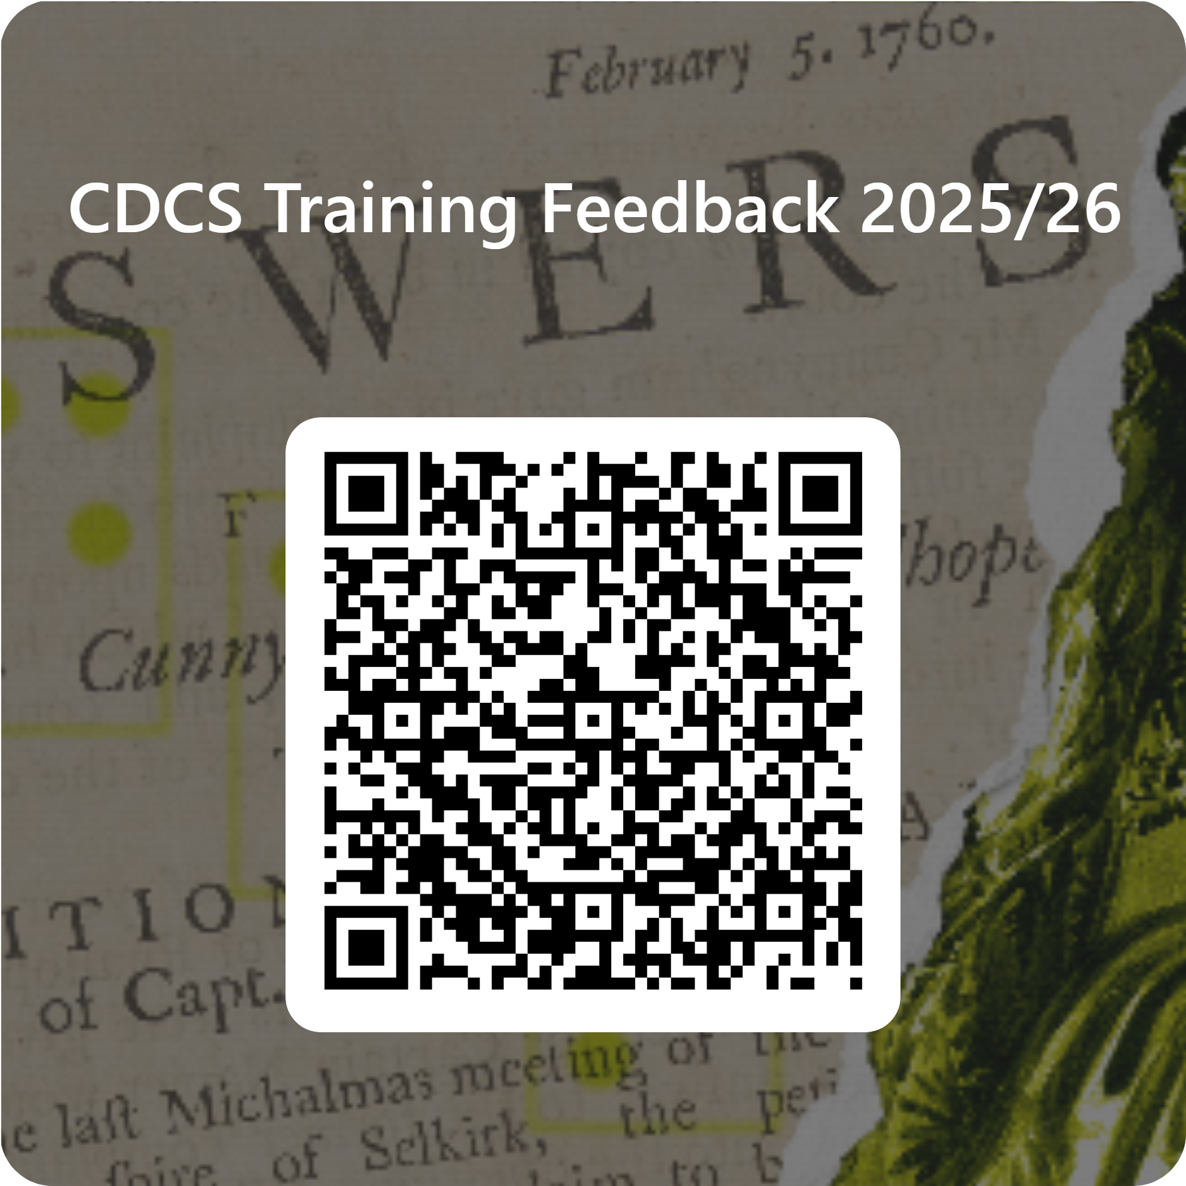
www.cdcs.ed.ac.uk

Slide 20
API use for research
Session 2
www.cdcs.ed.ac.uk
Notes:
Welcome from SI and Alex ---- SI to talk through the introduction

Slide 21
Housekeeping and itinerary
Session 2 - Day 3 03/12/25
APIs in practice
[14:00-14:15]: Introduction to session and recap
[14:15-14:40]: Exercise - working through API documentation
[14:40-14:55]: Feedback to group on exercise
10 -minute break
[15:05-15-50 +- 5 mins]: Practical with code book (accessing an API)
[15:50-15:55]: Discussion
Last 5 minutes
In closing: signpost to resources
Record attendance & feedback
www.cdcs.ed.ac.uk

Slide 22
Recap talk & plans
www.cdcs.ed.ac.uk
Notes:
Alex – cover fundamentals remaining

Slide 23
Exercise 1
Which API are you interested in?
Did you bring along some documentation?
Group together and go through some of key features listed in the documentation for API access.
Is it open or requires authentication?
Discuss and lay out the core features you would need
www.cdcs.ed.ac.uk

Slide 24
Quick feedback from the exercise
Any bottlenecks
Is the API suitable for your use case?
Any questions?
www.cdcs.ed.ac.uk

Slide 25
10 – MINUTE BREAK
www.cdcs.ed.ac.uk

Slide 26
Practical exercise
Programmatically accessing a web API to collect data
Groups or pairs
Setup (2 notebooks open)
Guided walk through with Somya (notebook on screen)
www.cdcs.ed.ac.uk
Notes:
SI – Aybuke & Alex

Slide 27
GITHUB repository
www.cdcs.ed.ac.uk
Notes:
SI – Aybuke & Alex

Slide 28
www.cdcs.ed.ac.uk

